Slide 1

THYNK UNLIMITED
SPEECH EMOTION RECOGNITION
WE LEARN FOR THE FUTURE
EE708
PRESENTED BY:
GROUP 8
Archita Goyal
Aritra Ambudh Dutta
Harshpreet Kaur
Saksham Verma
Suyash Kapoor

Slide 2
OBJECTIVE
The objective of this project is to develop a model capable of recognizing emotions from speech audio files by analyzing vocal characteristics and patterns.
This has practical applications in virtual assistants for improving user interactions, emotion-aware systems for sentiment analysis, and therapeutic applications for mental health assessment and support.

Slide 3
DATA PRE-PROCESSING
First and foremost, we have padded each sound wave with silence so as to keep uniform length. Next we broke each audio file into several parts, each of which had 1024 samples with a hop length of 512 (a 50% overlap). Each of the sample is gone through the cycle to extract 64 mfcc’s
MFCC selection
Therefore each of the sample is converted into 64 numbers(64 because we have extracted 64 mfcc’s). So each audio file is converted into a 2D array of 64 Rows and the column being equal to number of Samples performed.
In total, we worked with 1140 audio files, each converted into this 2D array format, ready for model training.
FFT
Log/Mel scale
DCT

Slide 4
PATH TO THE FINAL MODEL
We first trained a decision tree classifier using GINI index which was obtained by hyper tuning parameters. Being too simple in nature, it only gave validation accuracy of 41%.
Next, we used Random Forest, which improved validation accuracy by aggregating multiple trees, reducing errors, and enhancing classification performance. However, it was still insufficient as the final model.
Our next approach was to implement an MLP (Multi-Layer Perceptron). We extracted 40 MFCCs and it used 128 nodes in the Hidden Layer 1, 256 in Hidden Layer 2 and finally 8 as the final output layer (8 being the number of emotions)

Slide 5
CNN MODEL ARCHITECTURE
Overview
Our custom CNN efficiently classifies emotions into 8 categories using depthwise separable convolutions, reducing computation while maintaining accuracy
Model Structure
Entry Block: Initial feature extraction with 7×7 convolution, followed by normalization and pooling
Three Specialized Blocks:
Each block uses depthwise (7×7) and pointwise (1×1) convolutions
Progressive feature depth: 64→128→256→512 channels
Batch normalization after each convolution enhances training stability
Classification Pipeline
Global Average Pooling: Condenses spatial information while preserving channel depth
Dual Dropout Layers: Strategic 50% dropout provides robust regularization
Dense Layers: 512→256→8 neurons with ReLU activation between layers

Slide 6
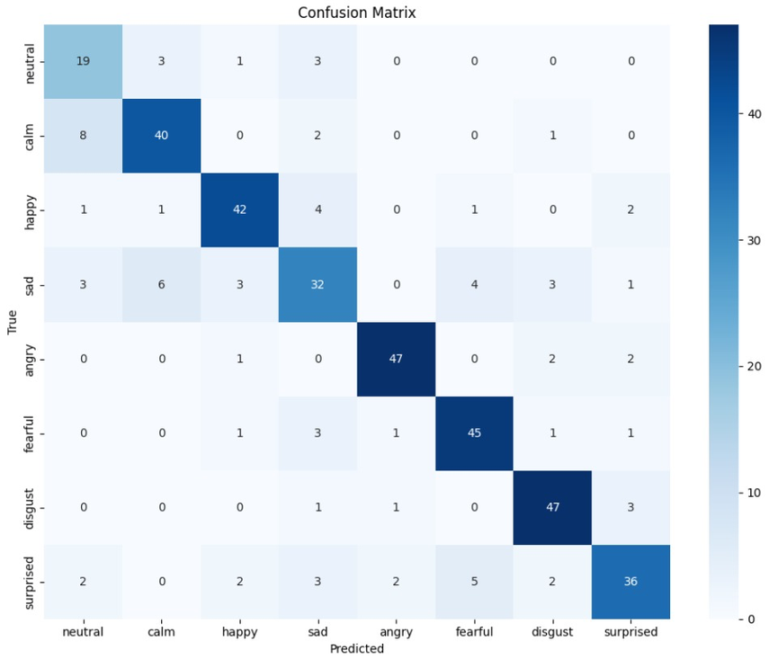
PERFORMANCE METRIC OF FINAL MODEL
ACCURACY
PRECISION
79%
(Validation)
0.80
F1-SCORE
RECALL
0.79
0.79
Confusion Matrix

